Slide 1
End-User Guide
Tao Zimmerman, Colton Hulce, Louis Najdek, William Atwood

Slide 2
Information Disclaimer
The testing performed was done in a safe environment, with no connection to any network. We are not responsible for any damages caused by attempting the content depicted in this presentation.

Slide 3
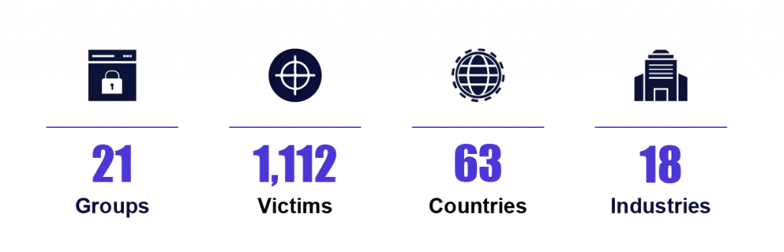
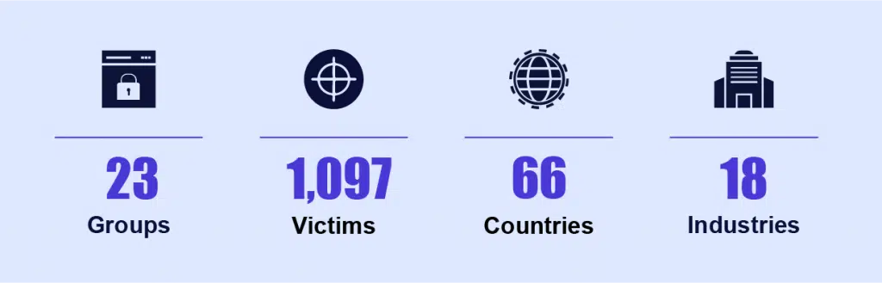
Introduction
“In 2020, 1,112 organizations were hit by ransomware attacks. In comparison, 1,097 organizations were hit by ransomware attacks in the first half of 2021.”
Source: https://www.cognyte.com/blog/ransomware_2021/

Slide 4
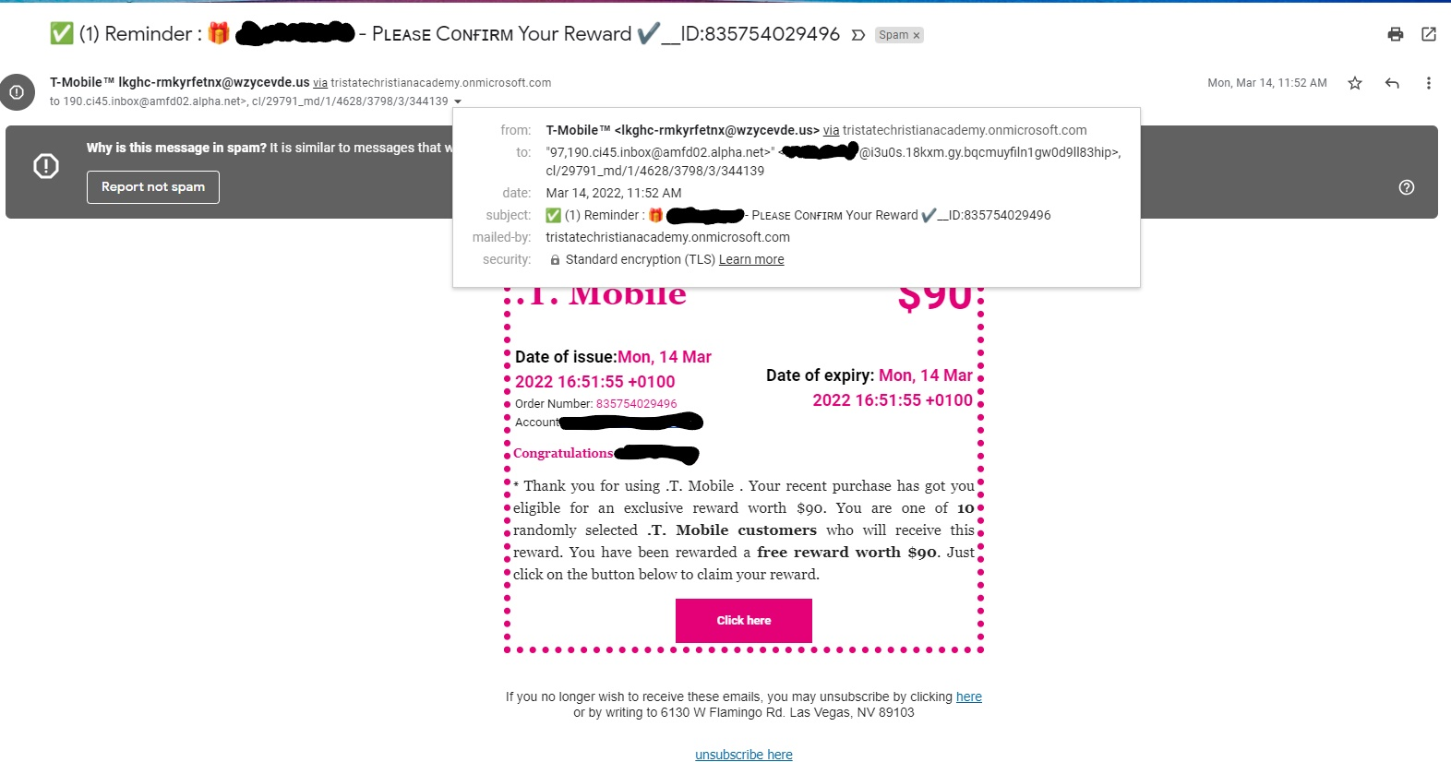
Attack Vectors - Phishing Emails

Slide 5
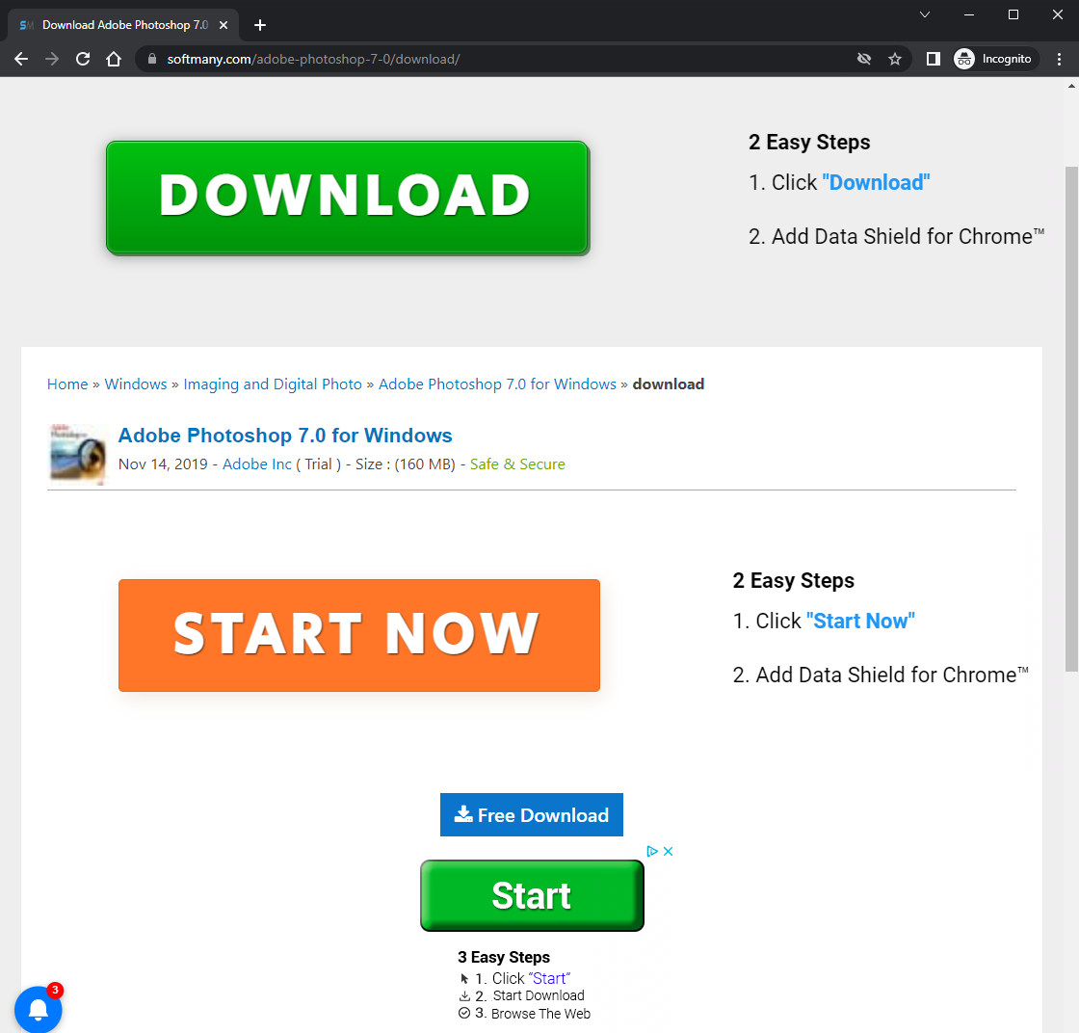
Attack Vectors - Downloads
Note:
The unofficial URL
The suggestion to download ‘data shield’ for chrome.
Not a single word is said otherwise, it just wants you to download data shield. Which is most likely bad for you.
The fake “download” and “start” buttons

Slide 6
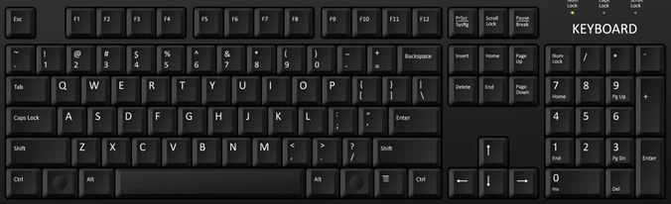
Internal Attacks

Slide 7
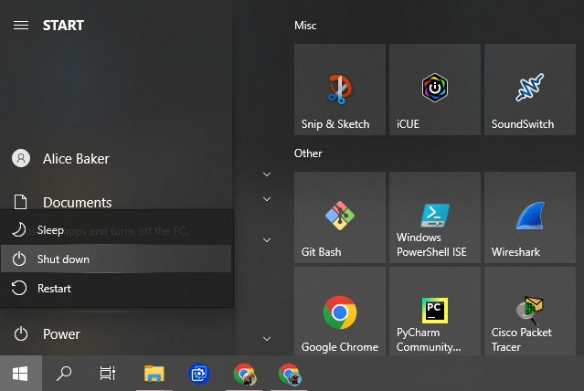

Slide 8
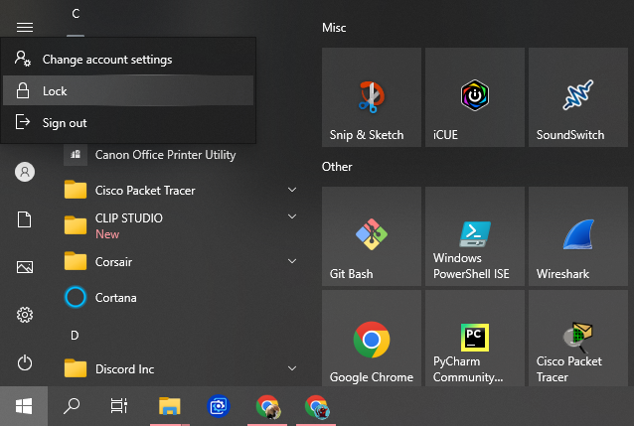

Slide 9

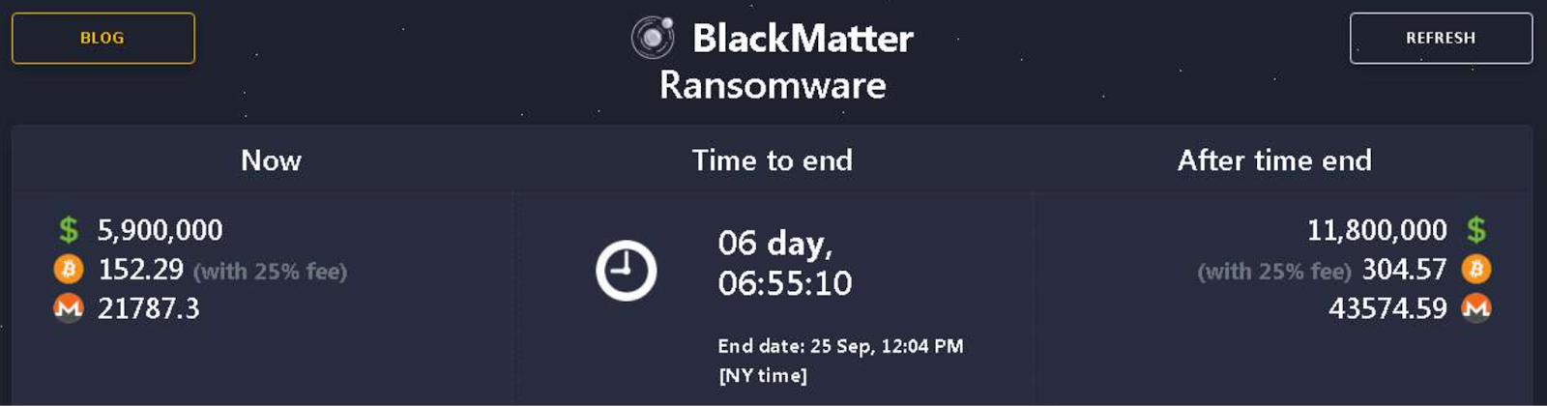
Indicators of Compromise

Slide 10
Sources
Introduction -
“Ransomware Attack Statistics 2021 - Growth & Analysis”. Cognyte. Cognyte. 08 Aug 2021. https://www.cognyte.com/blog/ransomware_2021/
Indicators of Compromise -
Ozarslan, Suleyman. “BlackMatter Ransomware Analysis, TTPs and IOCs”. Picus Labs. Picus Security. 21 Oct 2021. https://www.picussecurity.com/resource/blog/blackmatter-ransomware-analysis-ttps-and-iocs

